Slide 1
Digital Image processing
Assignment 2

Slide 2
Question 1
In this question i took around 220 images.
By using the concept of PCA(KL Transform) I reduced the dimensionality of image.
In this question the eigen vectors are arranged in ascending order so that the dominating or the eigen vectors corresponding eigen values are at the end(total eigen vectors are=4096)
Here are some results taking different eigen values

Slide 3
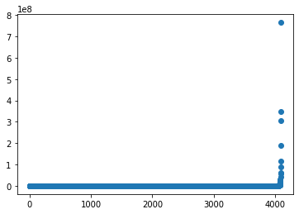
Eigen Value graph

Slide 4
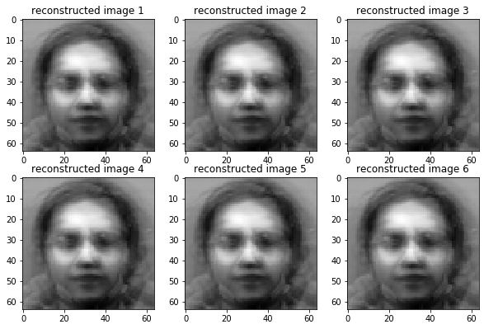
Initial eigen vectors only(1-1000)

Slide 5

1-3000

Slide 6
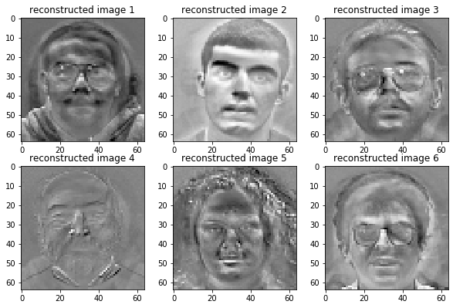
1-4090

Slide 7
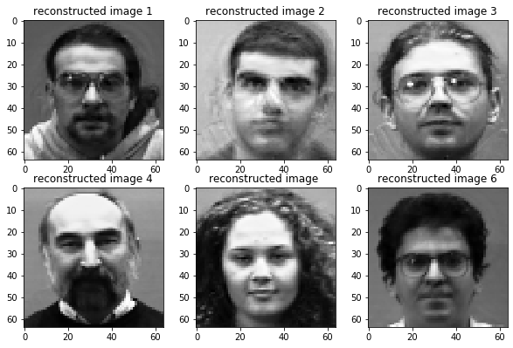
Taking the dominating eigen vectors(4080-4096)

Slide 8
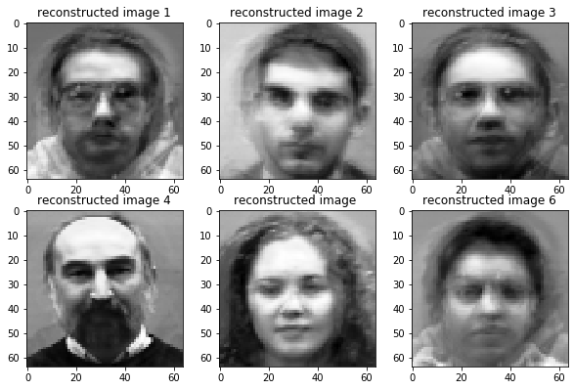
4092-4096

Slide 9
Taking only the single most dominating

Slide 10
Question 2
In this question I first designed filters and by doing operations in frequency domain with image, observed the results
In case of ideal low pass filter ringing effect is observed
In ideal high pass filter we observe edges along with noise
In gaussian low pass filter we observe filtered image without any ringing effect
In gaussian high pass filter almost similar results are observed as in ideal high pass filter

Slide 11
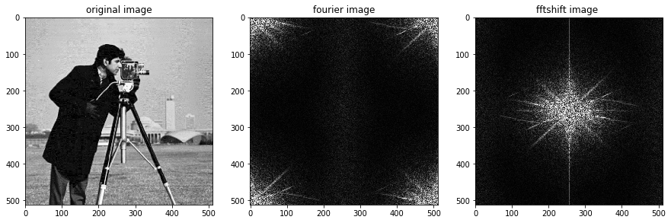
Original image in frequency domain

Slide 12
Ideal filter outputs
By taking horizontal and vertical cut-offs =40

Slide 13
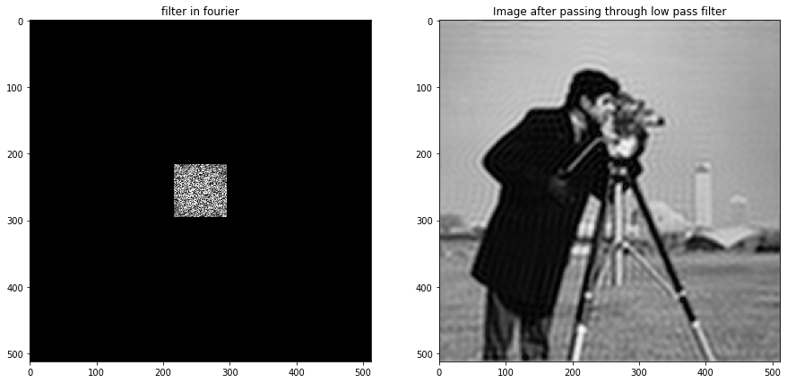
Ideal low pass filter

Slide 14
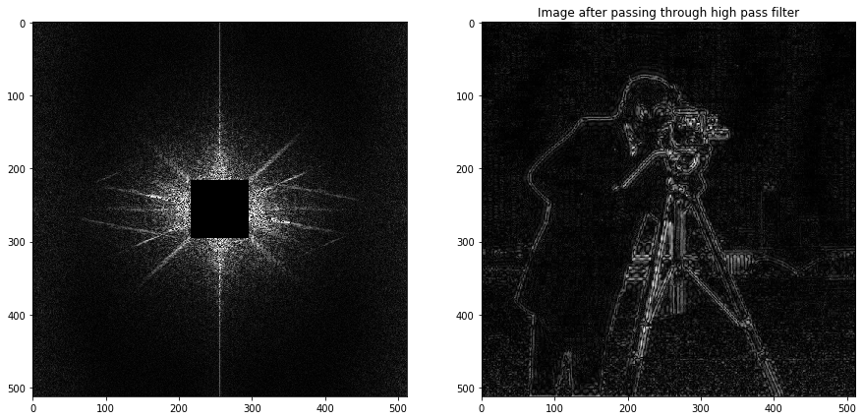
Ideal High Pass filter

Slide 15
Ideal filter outputs
By taking horizontal and vertical cut-offs =70

Slide 16
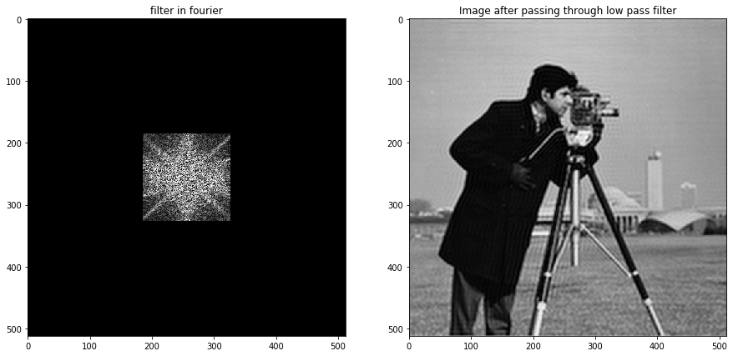
Ideal low pass filter

Slide 17
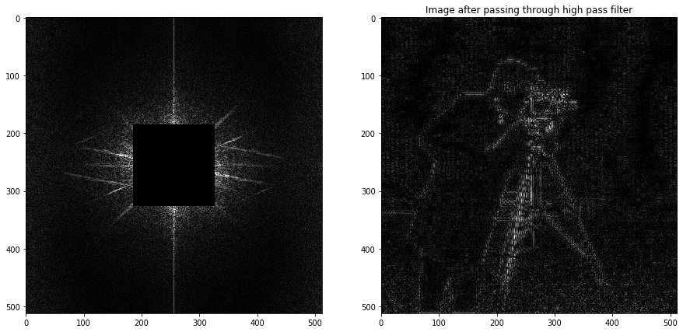
Ideal High Pass filter

Slide 18
Gaussian filters(Taking variance=40)
Here the variance value of gaussian filter is asked from user as input.
Mean in this case is taken zero.

Slide 19
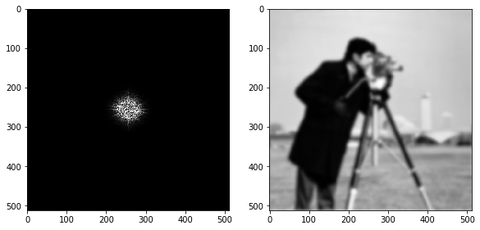
Gaussian low pass filter(Variance=40)

Slide 20
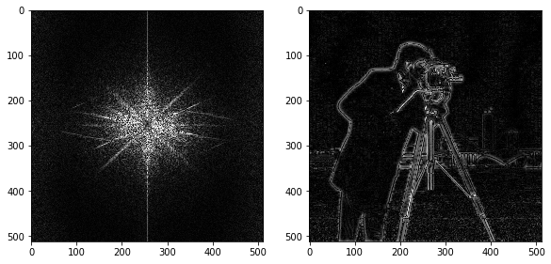
Gaussian High pass filter(Variance=40)

Slide 21
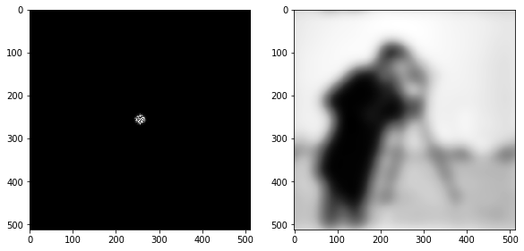
Gaussian low pass filter(Variance=10)

Slide 22
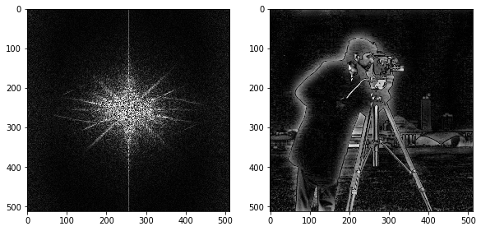
Gaussian high pass filter(Variance=10)

Slide 23
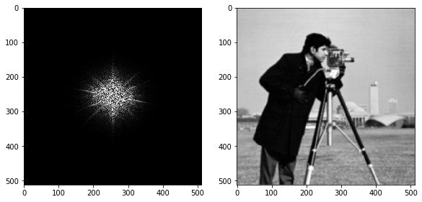
Gaussian low pass filter(Variance=100)

Slide 24
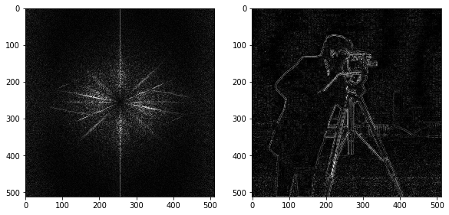
Gaussian high pass filter(Variance=100)

Slide 25
Question 3
In this question we took a coin image in which we detected circles by outlining the image by a ring
We used two different approaches to do this
First one is by using python’s inbuilt function ‘HoughCircles’ which returns the centre and radius of detected circles
Second one is by trying to get all the circles of a given range of radius by plotting all the boundaries predicted by algoritm
Canny’s algorithm is first used here to detect the outlin image of the circles

Slide 26
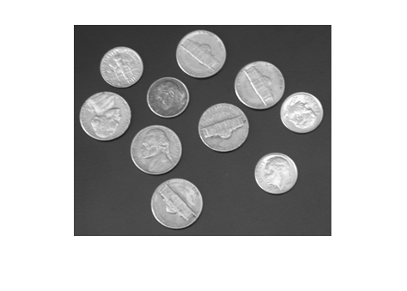
Original image

Slide 27
Using python’s function ‘Houghcircles’
The input given to the function are minimum and maximum radius of the circles to be detected
Result for minimum radius=30 and maximum radius=40

Slide 28
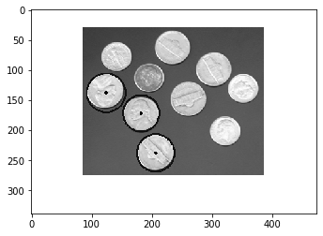
Using python’s function HoughCircles

Slide 29
By applying algorithm step by step

Slide 30
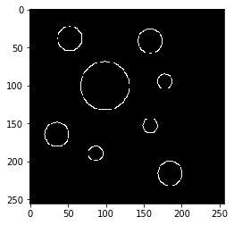
Step 1 (edge detection using canny’s algorithm)

Slide 31
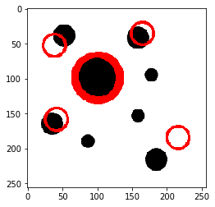
Step 2 (Drawing outlines using maximum intersections points in transformed plane)

Slide 32
Thank you
Manvendra Singh(T19138)

